Slide 1
Real-Time Analytics Dashboard
Architecture Overview

Slide 2
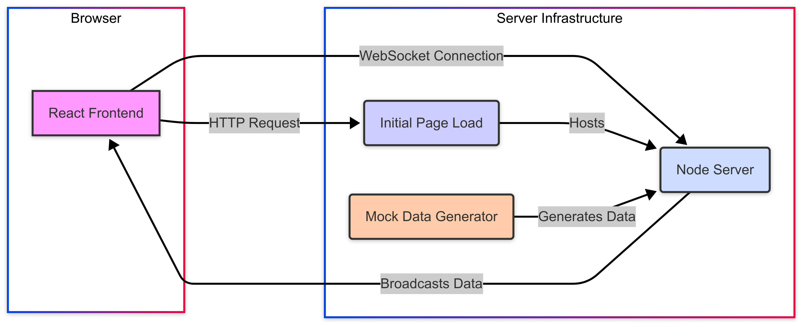
System Architecture

Slide 3
Data Flow
Client loads React application served by Vite
WebSocket connection established to backend
Server accepts connection, sends initial data
Every 2 seconds, server generates new mock data
Server broadcasts data to all connected clients
React components receive data via WebSocket
UI updates in real-time without page refresh

Slide 4
Frontend Architecture
React + TypeScript
Vite for fast development and bundling
Component Structure:
- App.tsx (Root component)
- Dashboard.tsx (WebSocket handling, state management)
- ActiveUsersCard.tsx (Display active users count)
- PageViewsChart.tsx (Line chart using Recharts)
- AvgSessionDurationGauge.tsx (Duration display)
Recharts for interactive data visualization
Environment variables for configuration (.env)

Slide 5
Backend Architecture
Node.js + Express
TypeScript for type safety
WebSocket Server (ws library)
Mock Data Generation:
- Random fluctuations with constraints
- Simulation of realistic metrics
- Periodic updates via setInterval
Deployment behind Nginx reverse proxy
Server endpoints:
- HTTP endpoint for health check
- WebSocket endpoint for real-time data

Slide 6
Real-Time Implementation
WebSocket protocol for bidirectional communication
Server-side:
- Client tracking with wss.clients collection
- Broadcast mechanism to all connected clients
- JSON serialization for data transfer
Client-side:
- useRef hook to maintain WebSocket connection
- useEffect for connection lifecycle management
- Auto-reconnect on connection loss
- useState hooks for reactive UI updates

Slide 7
Data Visualization
Recharts library for React-based charts
Visualization components:
- Line chart for Page Views over time
- Card component for Active Users
- Text/gauge display for Avg Session Duration
Responsive design for various screen sizes
Data management:
- Limited history (30 data points)
- Dynamic X-axis with time formatting
- Animated transitions between data updates

Slide 8
Deployment & Summary
Deployment architecture:
- Frontend: Static files served by Nginx
- Backend: Node.js process (PM2)
- Nginx as reverse proxy (craftmyplate.gunpreet.in/api)
- WebSocket proxy configuration
Key strengths of the architecture:
- Real-time updates without polling
- Type safety with TypeScript
- Modular component structure
- Scalable for future enhancements

